Slide 1
Gentrification, Displacement, and the Impacts of Council Estate Renewal in Twenty First Century London
Prof Loretta Lees, Dr Sue Easton, Dr Nick Tate, Natalie Smith, Leics, &
Prof Phil Hubbard, Dr Jon Reades, Dr Adam Elliot-Cooper, King’s College London

Slide 2
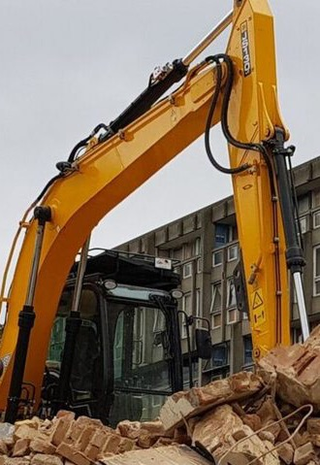
The London clearances
161 estates, or 198 separate schemes
In total, 54262 units demolished since 1997 (we do not know how many people this represents, though average council unit in London is 2.8 occupants so 151,000 estimate)
Estates affected had c. 77,851 units in 1997, 123,548 post regeneration (including estimates here) so net gain of 45,000 units on these estates
These estates now 2% council homes, 25% social rent, 15% affordable, 4% intermedate, 4% split ownership, 54% market rate

Slide 3
Major schemes (1000 demolitions plus)
Aylesbury Estate (SOUTHWARK) | 2758
South Acton Estate (Acton Gardens) (EALING) | 1998
Woodberry Down (HACKNEY) | 1980
Kidbrooke Village (Ferrier Estate) (GREENWICH) | 1910
Stonebridge Estate (BRENT) | 1569
Gascoigne Estate East (Weaver's Quarter) (BARKING) | 1356
Clapham Park Estate (LAMBETH) | 1307
Heygate Estate (Elephant Park and Trafalgar Place) (SOUTHWARK) | 1212
Roundshaw Estate (SUTTON) | 1143
Morris Walk Estate North and South (GREENWICH) | 1064
Northumberland Park (Stellar House) | 1027

Slide 4
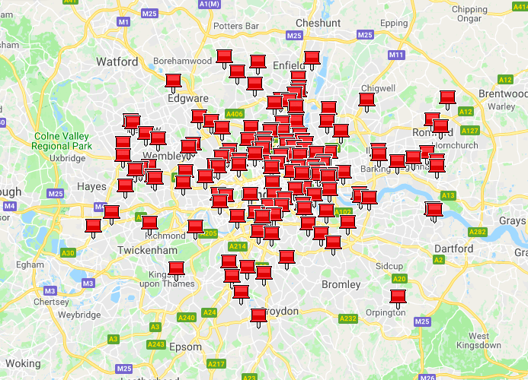

Slide 8
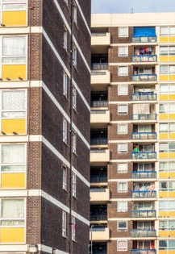
Data difficulties
Problems:
some LAs simply supplied no data on council housing or ex-council holding, others appeared incomplete;
planning documents do not contain all details of existing tenure;
some partial renewals and demolitions make reference to tenure mix only to that part of the estate, not the whole;
Section 106 agreements and renegotiation of initial % of social housing because of ‘changing financial circumstances’;
developers and architects websites vague and misleading; dates decanting or demolition began approximate in some case (especially back to 1990s);
Overall: huge data deficit! We can never be absolutely sure what was demolished, who was displaced, or what housing replaces what was lost

Slide 9
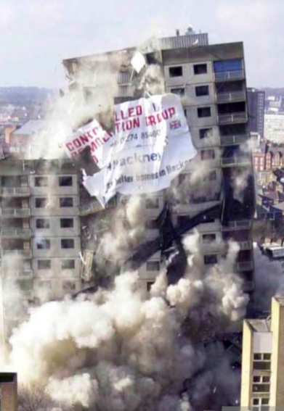
Violence of displacement
“Systemic violence operates anonymously, systemically and invisibly through the very way society is organised, as opposed to physical, or ‘subjective’, violence” (Baeten et al 2017: 639)
“Symbolic violence is imposed by language and discourse…clearly visible in the interaction between landlords and tenants in shape of ‘letters of approval’ which do not provide an option to disapprove, alongside subtler tactics of harassment and attempts to render opposition impossible” (Baeten et al 2017: 639)

Slide 10
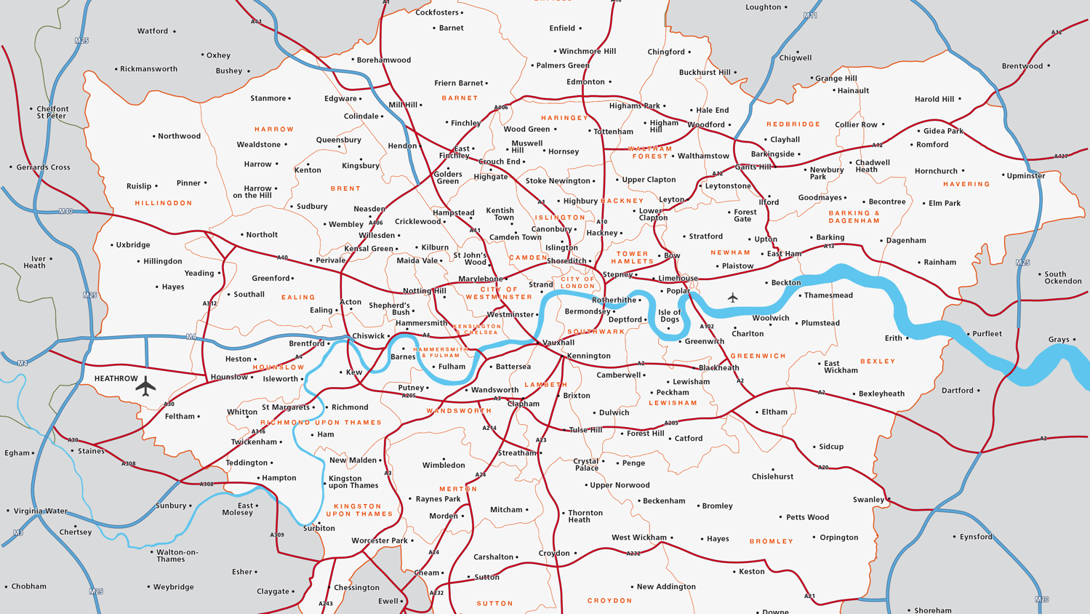
Love Lane, Haringey
Carpenters,
Newham
Ocean,
Tower Hamlets
Gascoigne,
Barking & Dagenham
Pepys
Lewisham
Aylesbury,
Southwark

Slide 11
Reluctant movers
“… I am staying in my house, and I do not want to move. Who wants to move me? So, if you want to move me, you cannot say that ‘I am moving you to this place’ which is not comfortable for me. I like it here! I don't want anybody to take this from me, I don't want problems with anybody” (Interview, Aylesbury Estate).

Slide 12
Reluctant movers
“It is a very stressful thing moving home. For one thing, you have already built up and rapport with the neighbours where you live. You are leaving all of that behind. It takes a while to get used to strangers…Where I am, the lady upstairs, she has got my street door key and I have got hers…She could come in any time she likes and takes what she wants, but she wouldn’t do that because, we have built that secure trust as a neighbour. So we need to have a neighbour because you never ever know what is going to happen in your life” (Interview, Aylesbury estate)

Slide 13
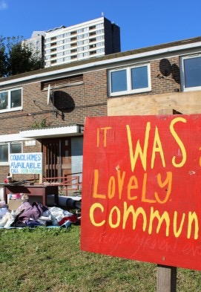
A sense of loss
“It is like, and then I’m thinking well no, I have got fantastic neighbours, honest to God my neighbours are just fantastic. I wouldn’t, I don’t think I know anybody who has good neighbours as I have. And that is the truth, you know. Even when I was in Bethnal Green, I had good neighbours, but… you just can’t touch it [here]. And it is like, I will be leaving all of that.” (Interview, Carpenter’s Estate)

Slide 14
A sense of loss
“I mean, I was brought up here, in this area, I have always lived in Newham. Newham’s the only place, it is more sociable you know, like it has got every multicultural people living here. A few of everyone and I like it here. And I don't want to move out, my children don't want to move out too. And you know it is very hard to find a place. Getting used to the place, do you understand?” (Interview, Carpenter’s Estate)

Slide 15
A sense of loss
“It breaks you, it breaks your heart, because it is a nice place, it is nice and quiet, no disturbance, no road worries, no fears, because the police are around, and there is a police station…So, I see them every day, they see me, it is just the local thing. It is just all about community in the end. It is sad, it is sad. Because, it is all, memories, the life history, and like, a lot of things you leave behind, it takes time to settle elsewhere.” (Interview, Carpenters’ estate)

Slide 16
Disrupted lives
“When you have kids is just like, it is one of the most important things is stability….To move somewhere far and have our support networks cut off, and if our support is cut off, it is going to struggle for us because, I do so much hours at work, she has is to look after the kids and, each day I am gone, it takes a strain on her, because they wake up at six o'clock, five o'clock sometimes and I don't know how she does it. It’s a tough one” (Interview, Pepys estate)

Slide 17
Disrupted lives
“I think it is depressing. It is really depressing because, I don't know what is going to happen, and I don't know whether to register my son at nursery down here, or if I should, register him at nursery everywhere, outside of the area... I don't know what is going to happen with work, because, if I have to commute from all of the way out of London it’s gonna be crazy and stressful, I might as well not be working” (Interview, Love Lane)

Slide 18
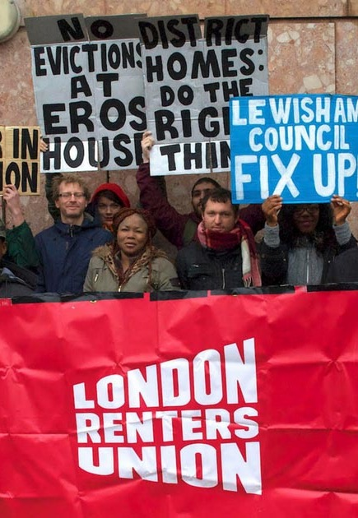
Democratic deficits
“It is not fair. You know, once they are doing something that big, you should have a one to one and you should have a solicitor and they should be talking about what is going on. We have had nothing like that…there is a ‘consultation’…They’re putting letters through your door, telling you how it is going to be to regenerate the area but they don't, there is no mention of demolition at all. Why not? A yes or no vote, that is all we want” (Interview, Love Lane)

Slide 19
Democractic deficits
”It is like we’re in the dark. It feels like any moment, you are, they will just decide, just like that, overnight, you will just see people start drilling in the house. You feel like somehow you don’t exist…. For you to do that to me, the home where you live, why they are going to knock it down? But you don’t know when. And they are not telling you when it is going to happen, they’re just telling you it’s going to happen.” (Interview, Love Lane)

Slide 20
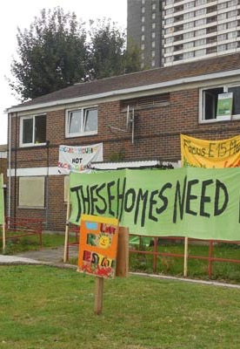
A life suspended?
“Sometimes, I don't know how many times, since last year… you don't have heat…I don't know how many times we don't have a heater and when you called them they will say that they know, they are doing it and nothing, that is it. Sometimes they won't tell us that there will be no hot water and they don't provide hot water, they'll be no heating system, …So they are just using all, every means just to force us to leave, to frustrate us” (interview, Love Lane)

Slide 21
A life suspended?
“Yeah, so, you know, if you want to do something in the home, home improvements, for improvements, that is on hold. Because you don’t want to be spending money, and then next month we have to move out, it is, so that’s on hold. It is like, it is just hanging up in the air, not knowing what is going to happen, and it has been like that since 2006” (Interview, Carpenters Estate)

Slide 22
A life suspended?
“All of the time it is on your mind, and it grinds you down. And it does make you ill. It makes you sick, it really does. You know. Sometimes I get quite depressed about it, another time to come- and if I’m getting emotional...It is hard, it is hard. Yeah, but we just have to plod on. And hope for the best and that is all you can do.” (Interview, Carpenter’s Estate)

Slide 23
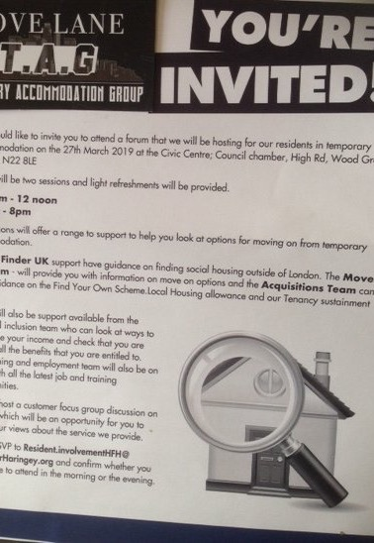
(Lack of) Resistance
“It is awful, and it is something, because of the uncertainty, all of those years you have been living with uncertainty. On top, if you have the mental health issues, I end up having most of the night, having a nightmare. And, all of the night I have been seeing, looking for a home but not finding a home. And then waking up really, sometimes, my sister wakes me up, because of my shouting. And everything, and you still somehow have to put a mask on your face, and go out and fight for your community, fight for your home” (Interview, Love Lane)

Slide 24
(Lack of) Resistance
“It is a … war of attrition, and it can be drawn out over many years as is shown in the case the leaseholders brought against Southwark council… and these people ,who are for the most part just trying to survive, cannot compete. So yes this is a tactical way to kill the fight in people” (Interview, Aylesbury Estate).

Slide 25
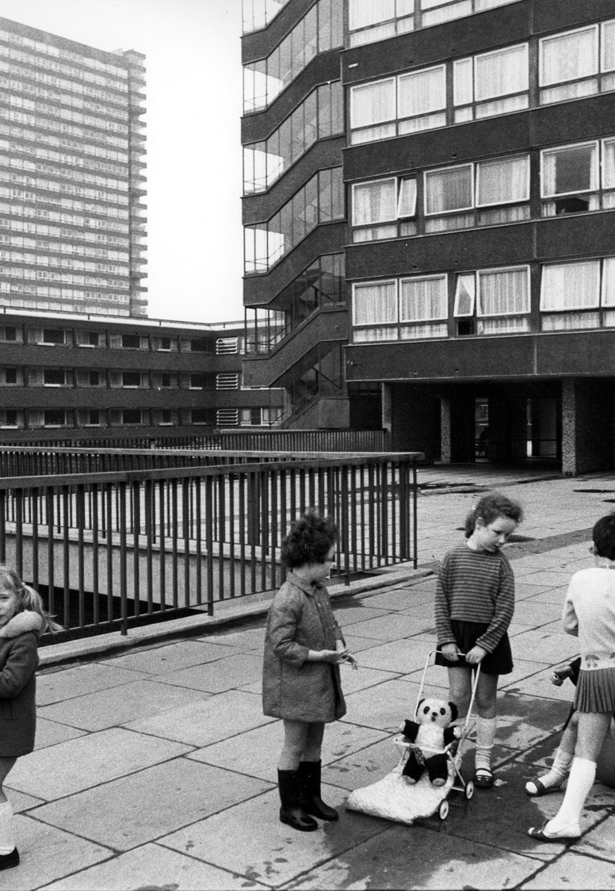
Conclusions
Displacement pressure is protracted and effects are varied and far-reaching:
Anxiety of loss of place, community and sense of belonging
Stress of not knowing what will happen
Concerns about access to key services, transport, work, schools etc.
Perception of racism and unequal treatment
Inability to contest regeneration plans – deliberate ‘divide and rule’ strategies?

